Slide 1
Google Data Analytics Capstone Project:
Cyclistic Case Study with SQL and Tableu
By Marcos López

Slide 2
Index
Background/Introduction
Ask
Prepare
Clean and Process
Analyze
Share
Act

Slide 3
Background / Introduction
The analysis is based on the first case study of the Google Data Analytics Certificate. I am assuming the position of a ‘Jr. Data Analyst’ role at Cyclitic, a bike-share company based in Chicago. The aim of the analysis is to understand the behaviors between Cyclistic’s two main users: members and casuals. The reason why the company would like to understand the behaviors between the two is that the company’s membership numbers have been stagnant and the management team does not have strategies to help increase it. Analyzing the behaviors between the two would create insights that would help create strategies to promote their membership plan.
The data will be cleaned and analyzed using SQL and Tableau and will follow Google’s six-step process of processing data: ask, prepare, clean and process, analyze, share, and act.

Slide 4
ASK
In this phase, it is important to understand what are the major questions that drive the analysis. Given that the company has a problem with increasing its membership numbers and it has data about its users, it begs the question:
How do annual members and casual riders use Cyclistic bikes differently?

Slide 5
Prepare
The data for this analysis was collected from the source provided by the Google course. In turn, I will analyze the reports for each month of the year 2022. These reports are divided into 12 tables in .csv format.
The tables used by the project were parsed using queries in Microsoft SQL Server, so some SQL functions used in other servers, such as MySQL, may not be possible and may have to be replaced by others.
Microsoft SQL server was chosen as it makes it easy to import and export tables with large amounts of information.

Slide 6


Combination of tables
To perform this task I used the following query:
This is the only query I found that would allow me to create a new table with all the data from the previous one.
To join the rest of the tables I must do the following query:
This is the only way I found to join all the information from a table to an existing one. I made this query with all the tables, month by month.

Slide 7
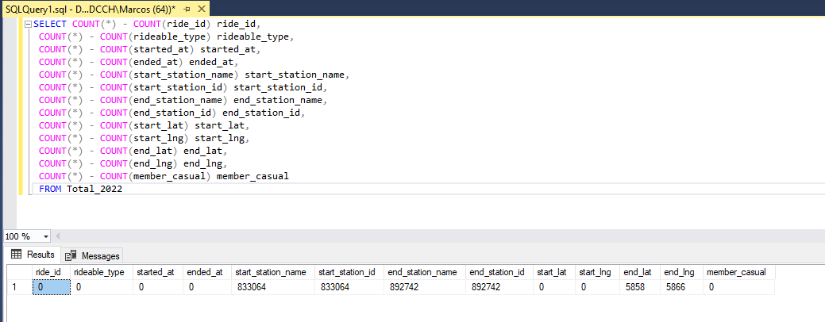
Clean and Process
With this query I was able to verify how many duplicates there were:

Slide 8
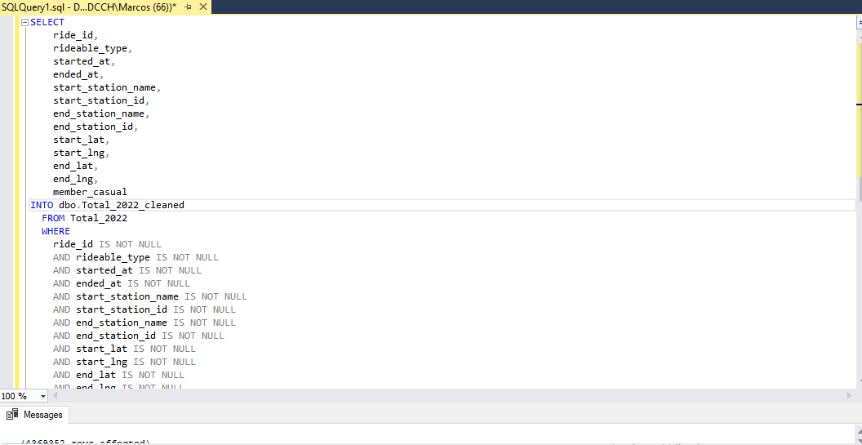
This query allowed me to delete all the NULL spaces that existed between all the data and create a new clean table:

Slide 9
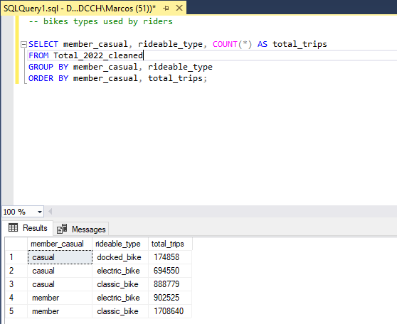
Analyze
With the new and clean table, now it is time to answer a series of questions that allow us to understand the behavior of those who use bicycles and the differences between members and casual users. Some of the questions we will ask are answered in the conclusion or in the data visualization part.
This query allows us to see what type of bike is most used among casuals and members. We can see that the classic bicycle is the most used by both groups.

Slide 10
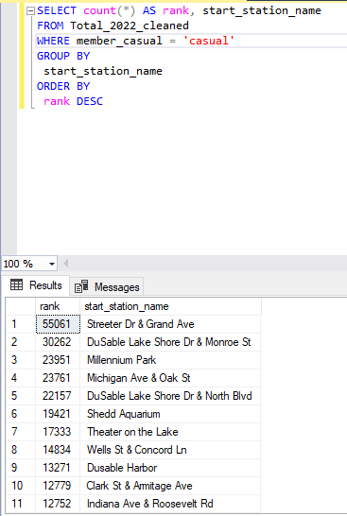
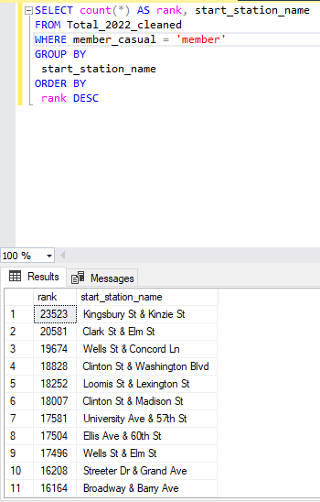
This query allows us to see which are the most used stations by both groups. In this case, members tend to use the "Kingsbury St & Kenzie St" station more, while the casual members use the "Streeter Dt & Grand Ave" station.

Slide 11
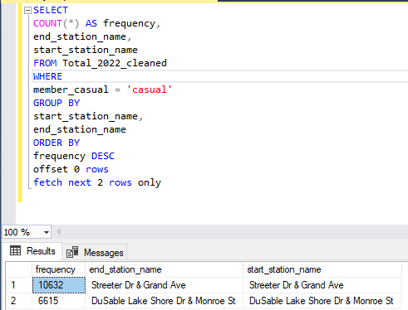
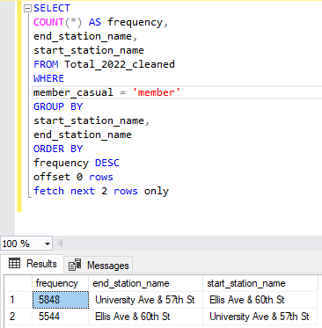
This query allows us to see which is the route most used by both groups. Members usually go from the "University Ave & 57th St" station to the "Ellis Ave & 60th St" station. Instead the casual ones go from "Streeter Dr & Grand Ave" to "DuSable Lake Shore Dr & Monroe St"

Slide 12
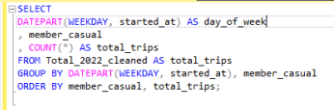
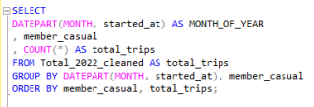
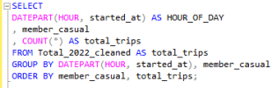
This query allows us to see the number of trips per day for both groups.
This query allows us to see the number of trips per month for both groups.
This query allows us to see the number of trips per hour for both groups.

Slide 13
Aclaration:
If you need to se the visualizations and the dashbord, copy the next link:
https://public.tableau.com/app/profile/marcos.lopez8357/viz/DashboardBikes_16952544784820/Dashboard1#1

Slide 14
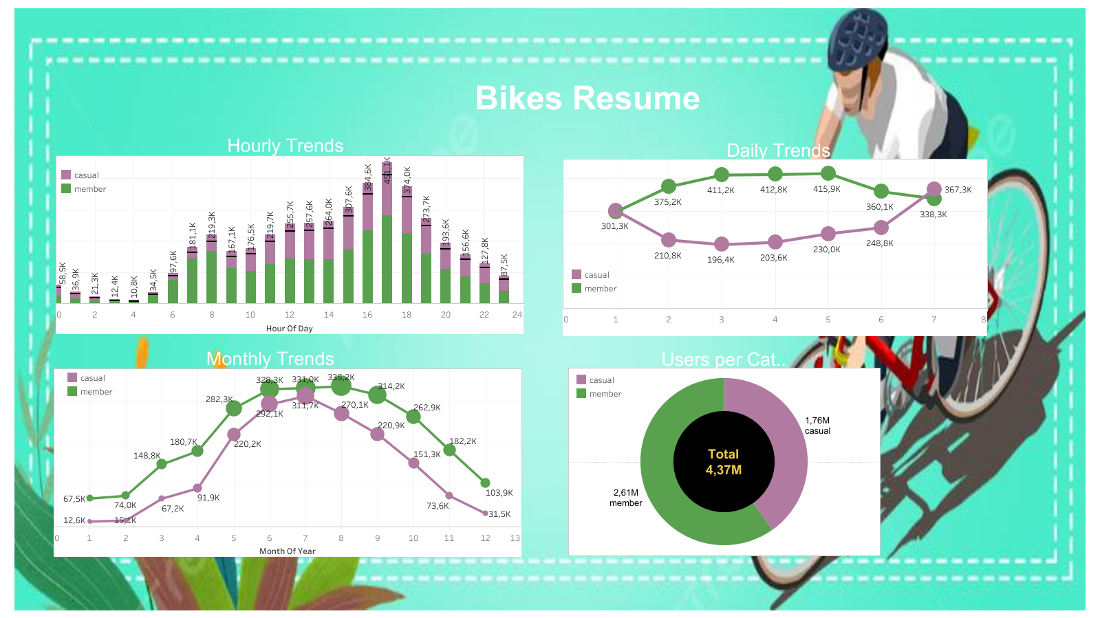

Slide 15
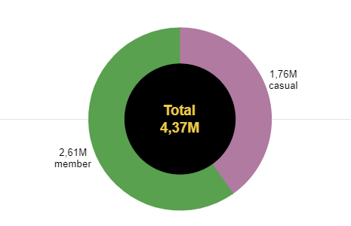
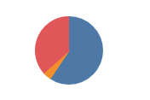

Who use the bikes more the members or the casuals?
What type of bicycle is the most used in total?

Slide 16
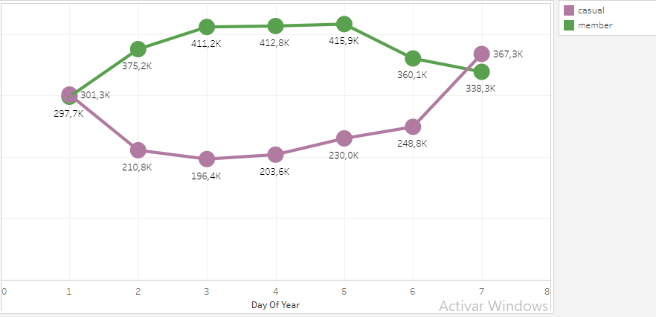
What is the daily trend of bicycle use?

Slide 17
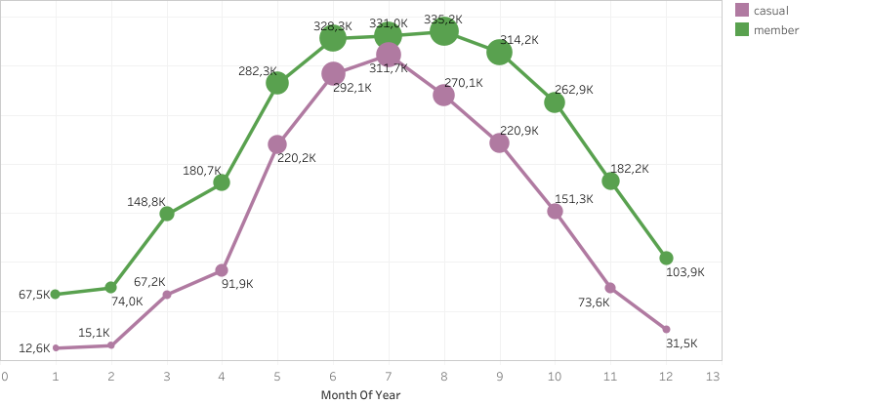
What is the monthly trend of bicycle use?

Slide 18
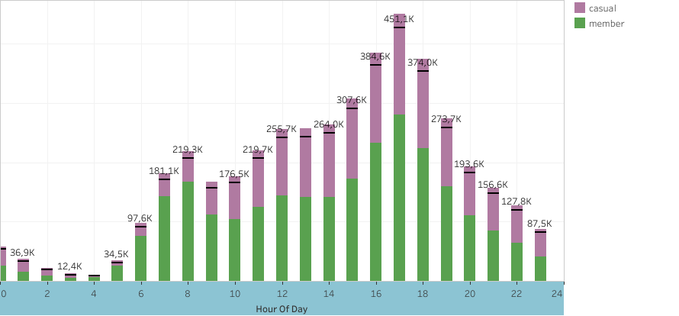
What is the hourly trend of bicycle use?

Slide 19
ASK
Members often use the bikes for work while non-members use the bike for leisure.
Members often use the bike during the weekdays while non-members often use the bikes during the weekends.
Both users prefer classic bikes to electric.
Recommendations:
Provide a membership package to categorize riders into two groups: leisure riders (people who use the bikes for leisure activities) and business riders (people who use the bikes for school or work).
When marketing Cyclitic bikes, use classic bikes as the main model of the bikes because most users like that more
Design classic bikes are unique for leisure riders and business riders. This enforces the idea of users being either a “leisure rider” or a “business riders”. This allows the user to be a part of a group identity and become a part of something bigger than them which could be attractive to some.
Make sure that there are enough bikes to handle the volume of riders during the weekends for leisure riders and weekdays for business riders.

